Slide 1
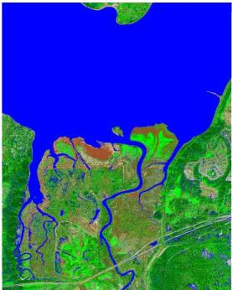
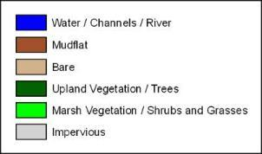
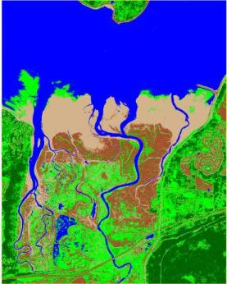
Aerial Photograph Habitat Classification
Purpose/Objective: To classify, delineate, and digitize boundaries for key estuarine habitats using high resolution infrared aerial photographs and spatial software (ERDAS Imagine and ESRI ArcGIS). When repeated over time, changes to estuarine habitat can be quantified.
December 2009
(post restoration)
March 2010
(post restoration)

Slide 2
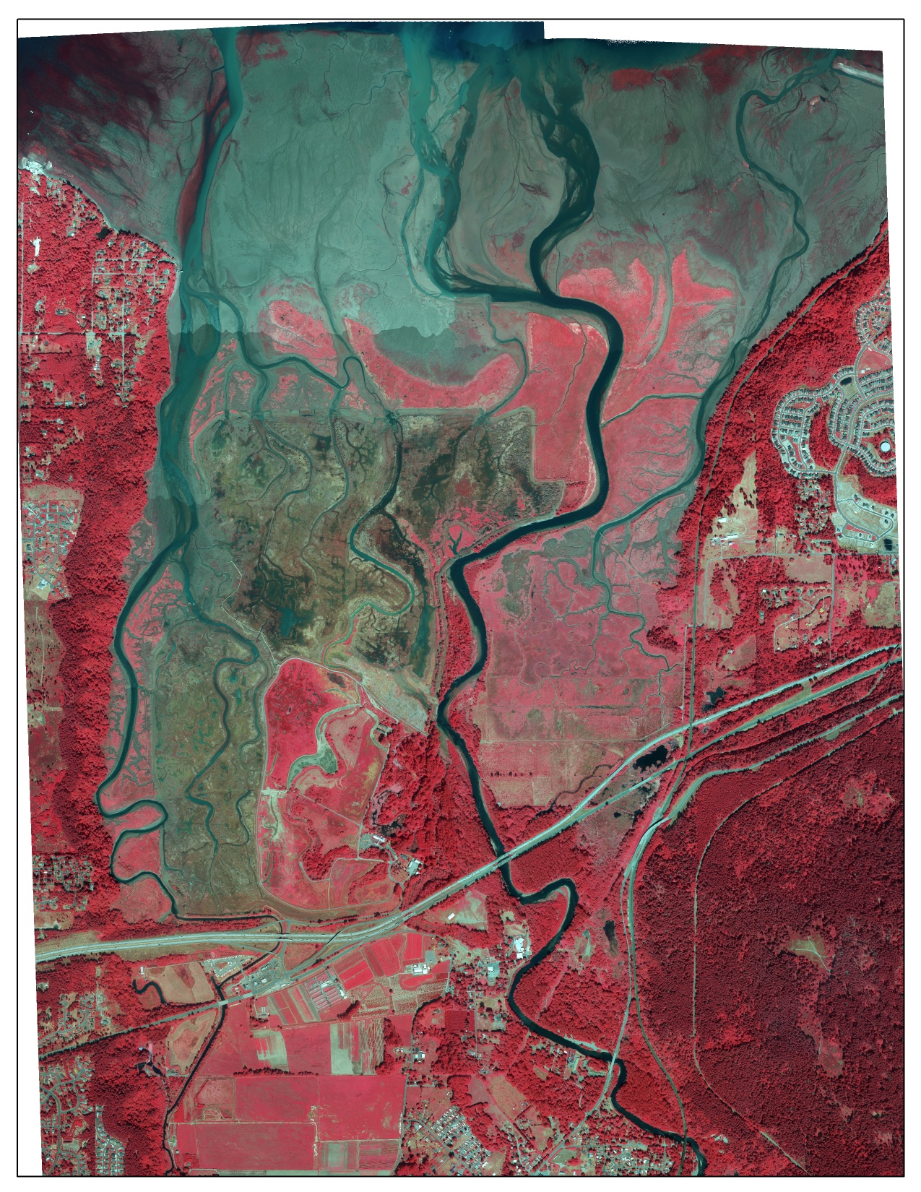
Considerations for Aerial Photographs:
False color infrared or 4-band
High resolution
Taken during peak vegetation growth
Taken during low tide
Nisqually Delta, WA
August 8, 2010

Slide 3
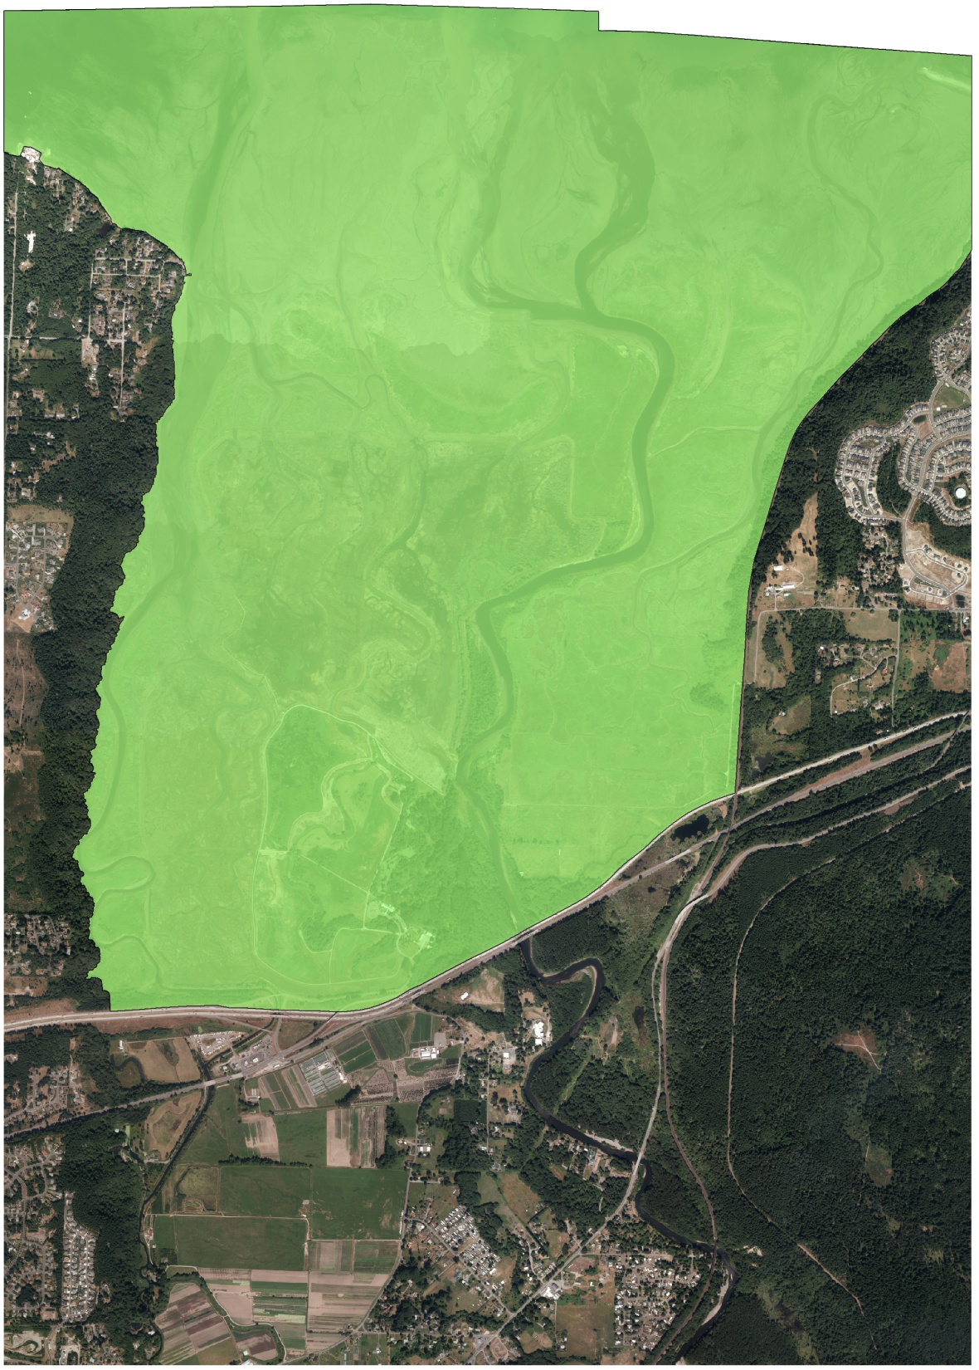
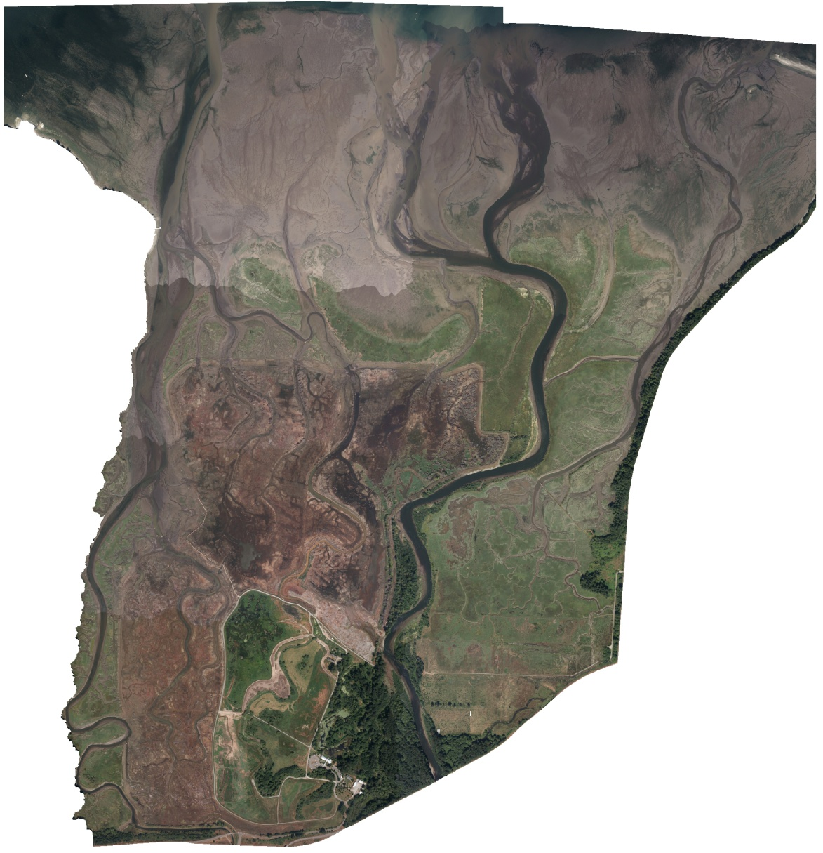
Image Preparation - Masking:
Create a polygon mask over your area of interest to reduce spectral variability.

Slide 4
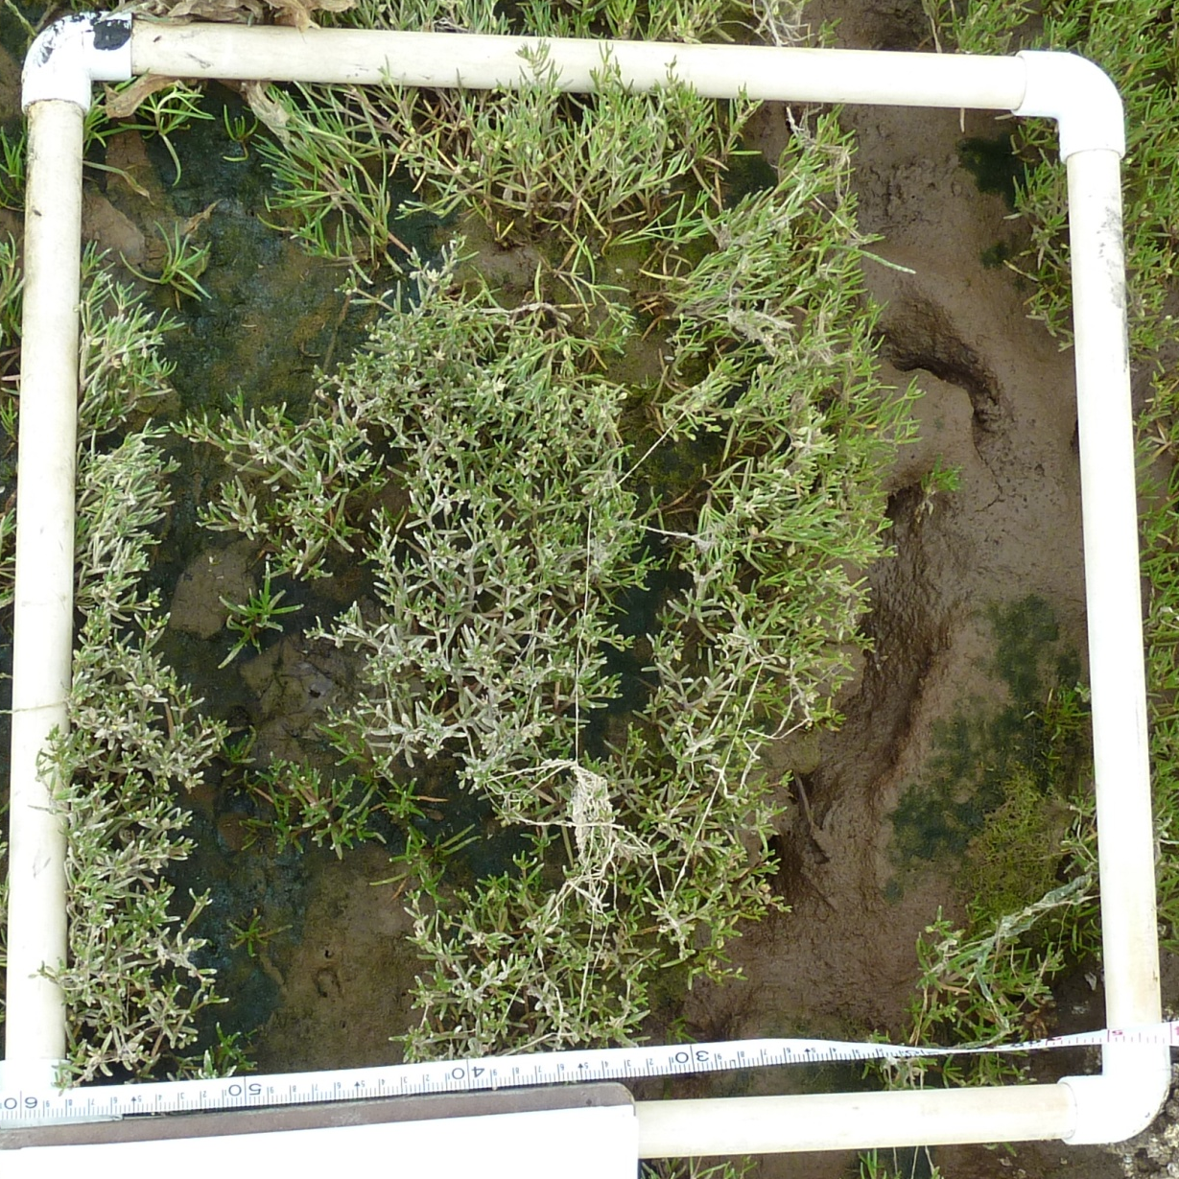
Image Preparation - Resampling (optional):
Reduce class confusion by resampling high resolution imagery to a courser resolution (i.e. size of a vegetation quadrat).
1 pixel = 0.5m x 0.5m vegetation quadrat

Slide 5
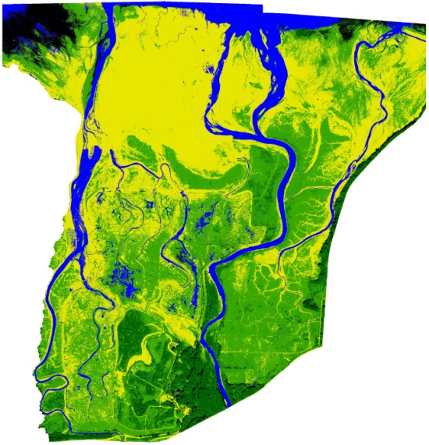
Unsupervised Classification (1st method):
Let ERDAS Imagine group pixels in categories automatically.

Slide 6
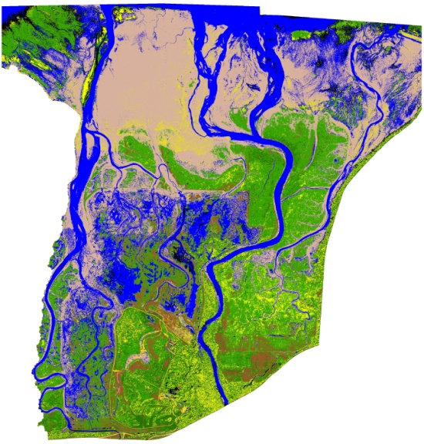
Supervised Classification (2nd method):
Manually create training sites throughout the imagery for each class.

Slide 7
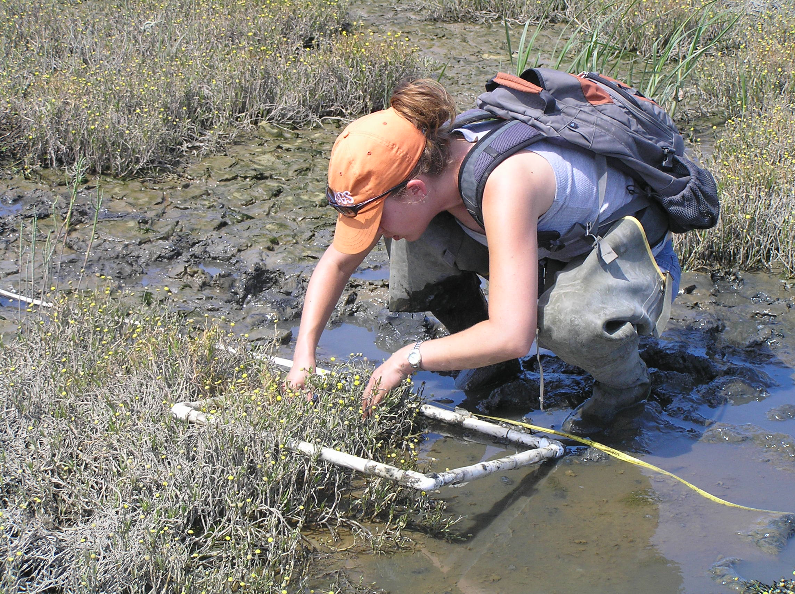
Ground -truthing:
Check classifications against real ground conditions.

Slide 8
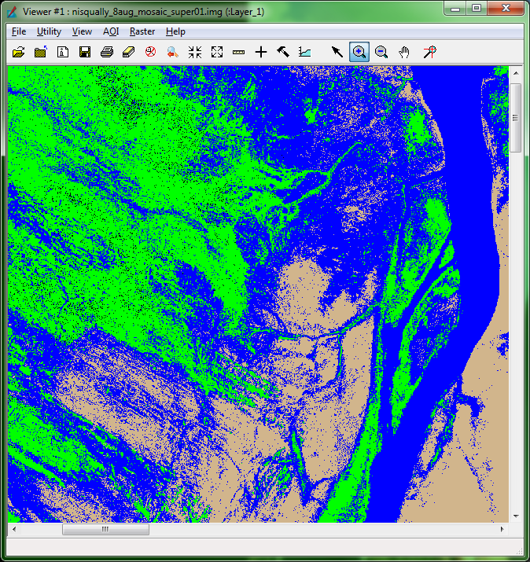
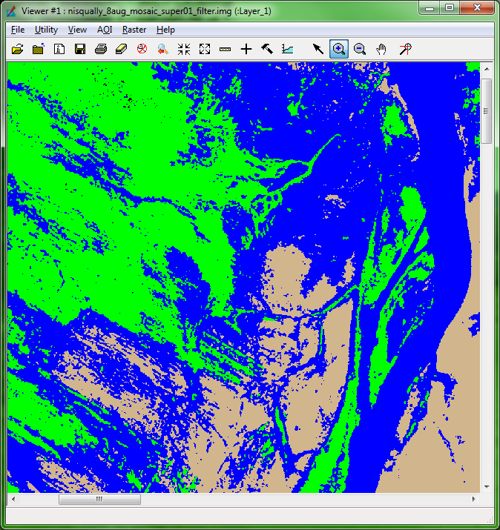
Classification Smoothing (optional):
Reduce salt and pepper effects and improve overall appearance of your images.
Before
After

Slide 9
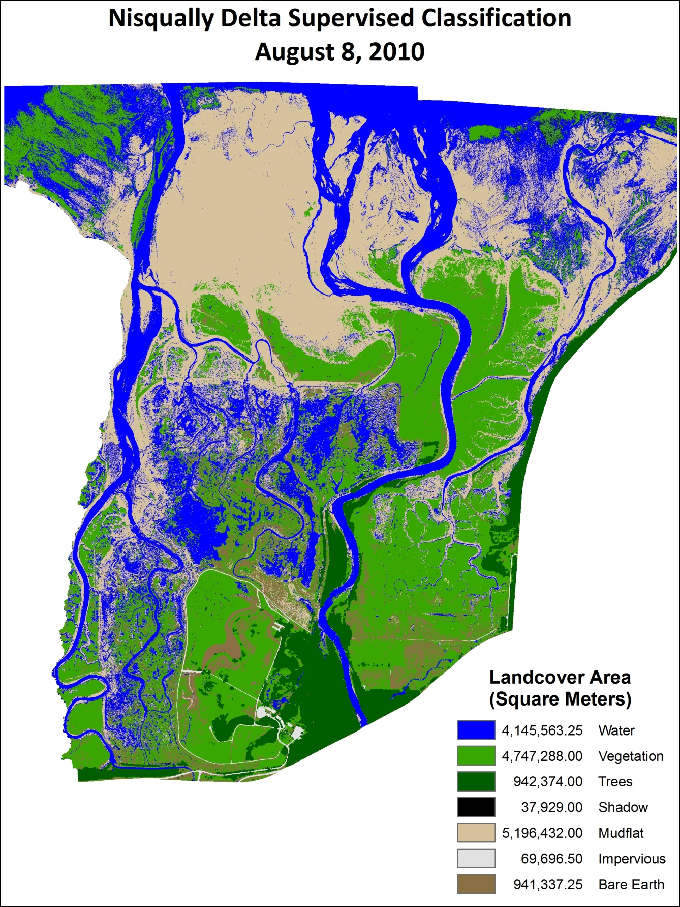
For a detailed, pdf version of these methods, use the link on the right to download the Aerial Photograph Habitat Classification SOP.

